Slide 1
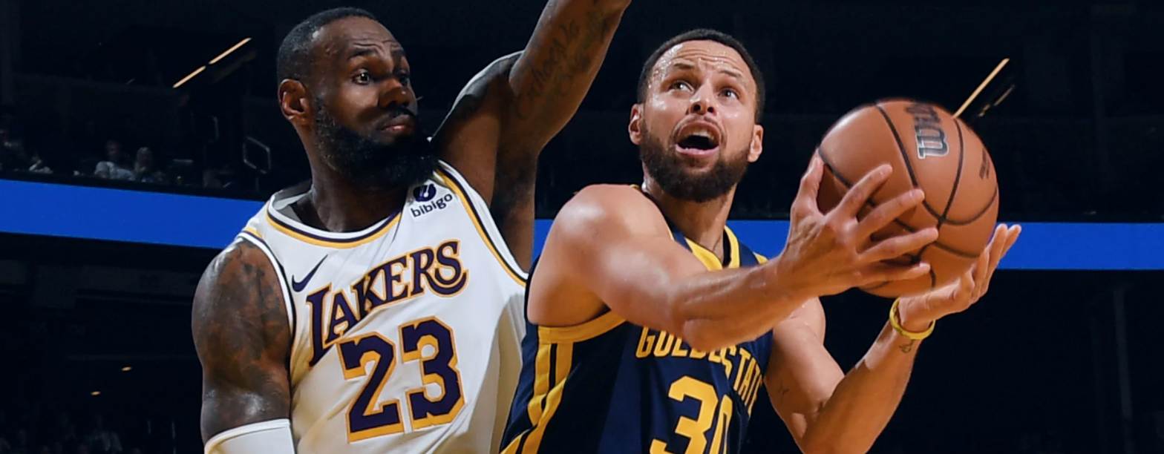
NBA Player Performance Analysis
An analysis of NBA player performance data from 2012 to the present, focusing on field goal percentage, 3-point percentage, free throw percentage, assists, and rebounds.

Slide 2



Project Overview
Analyze NBA player performance data
Understand offensive efficiency
Study shooting accuracy and play style
Analyze the relationship between shooting accuracy, team dynamics, and offensive strategies.
From 2012 to the present, focusing on key metrics such as field goal percentage, 3-point percentage, free throw percentage, assists, and rebounds.
Investigate the consistency of top performers and the impact of 3-point shooting in modern basketball.
This project aims to provide a comprehensive analysis of NBA player performance, offering insights into the evolving landscape of the game and the factors that contribute to team success.

Slide 3
Project Goals
Deeper Analysis of Offensive Efficiency
Explore the balance between scoring and playmaking by analyzing offensive contribution (points + assists) for top players and how it changes with minutes played and team dynamics. Investigate whether players with high offensive contribution are also efficient in terms of shooting accuracy and turnovers.
Team Dynamics and Offensive Strategies
Focus on high-scoring teams and analyze what specific strategies or player roles make these teams consistently strong in scoring, rebounds, and assists. Use advanced metrics like pace, offensive rating, and defensive rating to understand how team dynamics lead to success.
Shooting Accuracy and Play Style
Study players with high shooting accuracy in more depth, including three-point shooting specialists, and analyze how their scoring patterns differ from players with more traditional shot selection.
Consistency of Top Performers
Investigate players who appear across multiple metrics (efficiency, scoring, assists) and analyze how they maintain their performance across seasons and what metrics consistently predict high performance.
Team Evolution Over Time
Study team synergy by looking at the correlation between assists and points for top teams.
Impact of 3-Point Shooting in Modern Basketball
Explore how the rise of three-point shooting is changing the game, looking at trends in 3-point attempt rates over the years and the impact on team success.

Slide 4
Methodology
Data Ingestion
Load the NBA player performance dataset into a Pandas DataFrame for analysis and exploration.
Data Cleaning
Address any missing values, standardize data formats, and calculate additional performance metrics like win percentage.
Exploratory Data Analysis
Use descriptive statistics and visualizations to understand the characteristics of the data, including the distribution of shooting percentages and their relationship with team success.
Temporal Analysis
Examine how shooting performance has evolved over time, from 2012 to the present, to identify trends and patterns.
Positional Differences
Investigate differences in shooting accuracy among different player positions to uncover any position-specific insights.

Slide 5
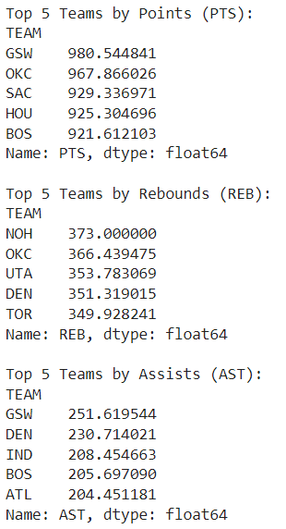
Top 5 NBA Teams by Performance Metrics
Golden State Warriors (GSW) dominate both scoring (PTS) and playmaking (AST), showcasing their well-rounded offense.
Oklahoma City Thunder (OKC) consistently ranks high in both scoring and rebounding, highlighting their strength in multiple facets of the game.
Teams like Denver Nuggets and Boston Celtics are also notable for their strong performance in both assists and rebounds.

Slide 6

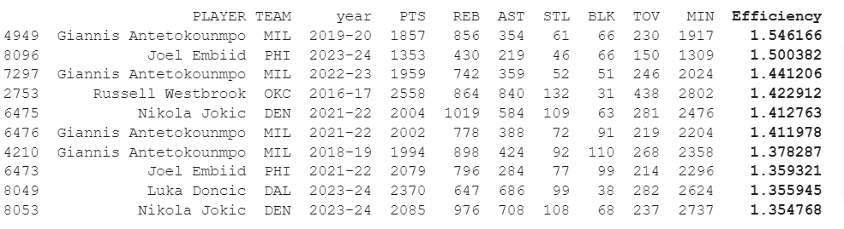
Most Efficient Players (Based on Simplified PER)
Giannis Antetokounmpo and Nikola Jokic frequently appear as the most efficient players
The Player Efficiency Rating (PER) values for these players range from 1.35 to 1.55, with Giannis reaching 1.546 in 2019-20.
*Source: Basketball-Reference.com

Slide 7
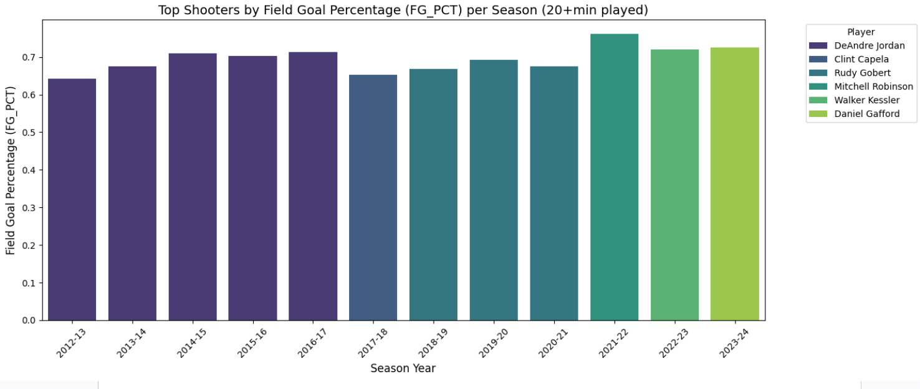
Shooting Accuracy and Team Success
Field Goal Percentage (FG%) of Top Shooters
DeAndre Jordan led the league in field goal percentage (FG%) for multiple years, with his highest shooting accuracy reaching 0.714 in the 2016-17 season.
Other players like Rudy Gobert and Mitchell Robinson also lead in FG% in subsequent seasons.

Slide 8
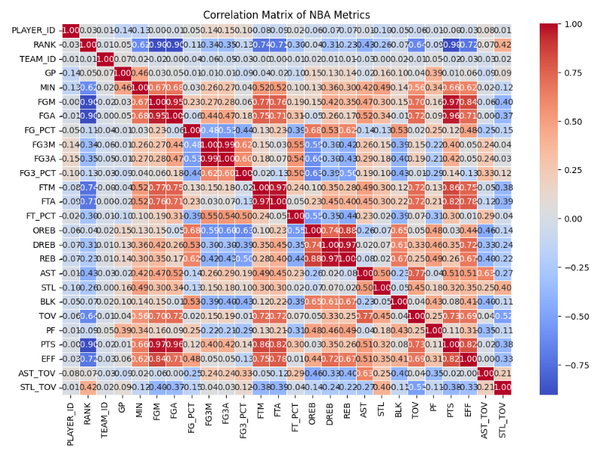
Correlation Matrix
The most strongly correlated metrics are field goals attempted/made with points, as well as minutes played with performance metrics like points and assists. Rebounds also show strong internal correlation between offensive, defensive, and total rebounds. These correlations make sense in the context of basketball performance, where key performance indicators tend to cluster.
Field Goals Made (FGM) and Points (PTS) have a near-perfect correlation (~0.99), as expected
Assists (AST) and Points (PTS) have a moderate positive correlation (~0.79), suggesting that players with more assists tend to score more points.
Minutes Played (MIN) correlates strongly with several other performance metrics like points, rebounds, and assists.

Slide 9
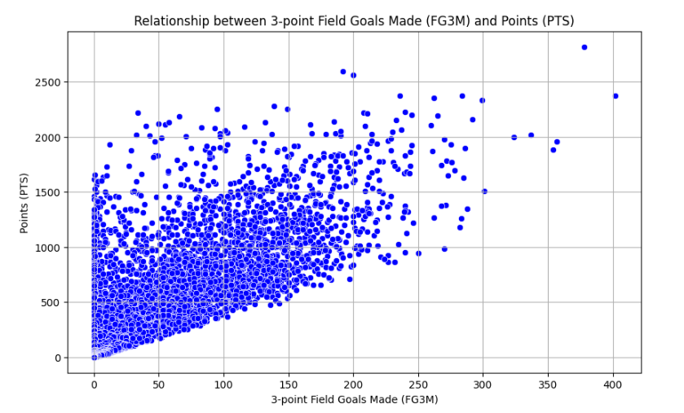
Correlation
3-point field goals made and total points
There is a clear correlation between making 3-point field goals and scoring high points.
However not all top scorers are necessarily the best 3-point shooters. Players like Shai Gilgeous-Alexander rely less on 3-pointers, while players like Stephen Curry and James Harden significantly contribute to their points through 3-pointers.

Slide 10
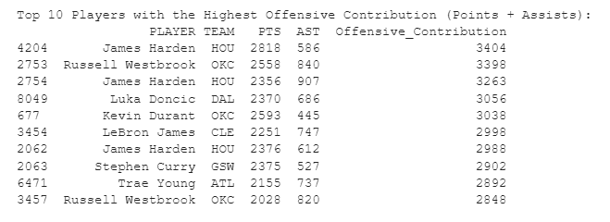
Offensive Contribution and Efficiency
This analysis explores the balance between scoring and playmaking for top NBA players. The table examines the top players' offensive contribution, measured as the sum of points and assists (PTS + AST).
James Harden has the highest offensive contribution (3404 points + assists)
Russell Westbrook, LeBron James, and Luka Doncic also rank high in their combined contributions to their teams’ offense.

Slide 11
NBA Player Performance Analysis
Dominance of top players in scoring and efficiency
Correlation between 3-point shooting and total points
Analysis shows that players like James Harden, Giannis Antetokounmpo, and Nikola Jokic have consistently ranked among the league leaders in both scoring and advanced efficiency metrics, demonstrating their outsized impact on the game.
The data reveals a strong positive correlation between a team's 3-point shooting percentage and their total points scored, highlighting the importance of perimeter shooting in the modern NBA.
The key insights from this analysis provide a comprehensive understanding of the current landscape of NBA player performance, emphasizing the dominance of elite players and the growing significance of 3-point shooting in driving team success.

